Slide 1





Aagricultural Raw Material Analysis
Student Details
Name: Roja R
NM Id: au2021107016
College Name: College Of Engineering Guindy- Chennai.

Slide 2

Aagricultural Raw Material Analysis
Disclaimer
The content is curated from online/offline resources and used for educational purpose only

Slide 3
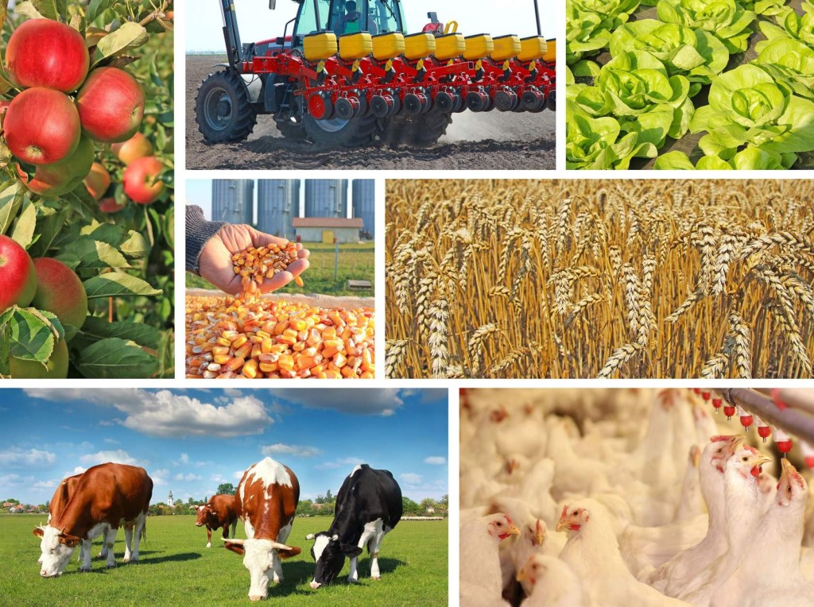
Aagricultural Raw Material Analysis
Course Outline
Abstract
Problem Statement
Aims, Objective & Proposed System/Solution
Introduction to Agricultural Raw Material Analysis
Importance of Data Analysis in Agriculture
Techniques and Tools for Raw Material Analysis
Model Development & Algorithm
Case Studies and Applications
Future Scope
Video of the Project
Conclusion
Reference

Slide 4


Aagricultural Raw Material Analysis
Abstract
In this presentation, we explore the significance of agricultural raw material analysis in modern farming practices. By leveraging data-driven approaches, farmers can enhance their decision-making processes and improve crop yield.
We delve into the challenges faced in traditional farming methods and propose a systematic solution utilizing advanced data analysis techniques.

Slide 5
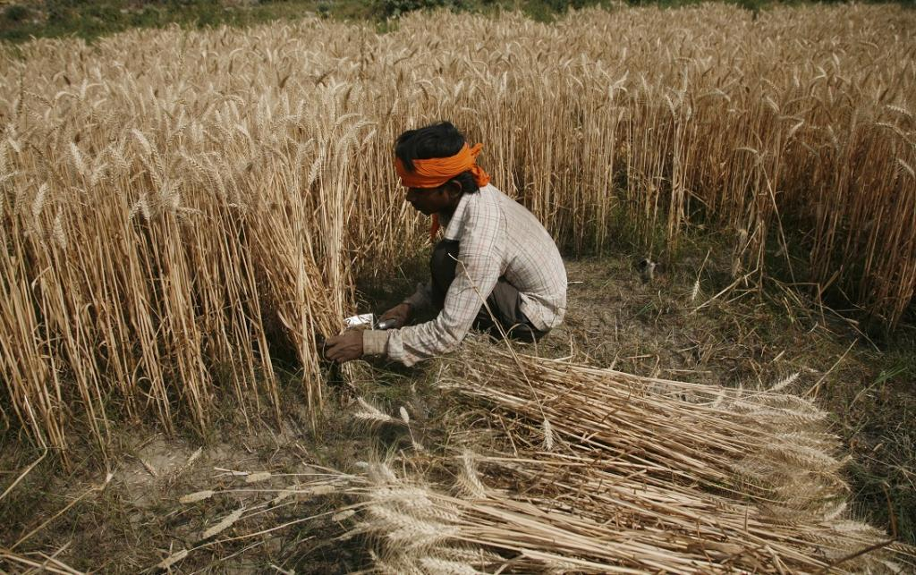
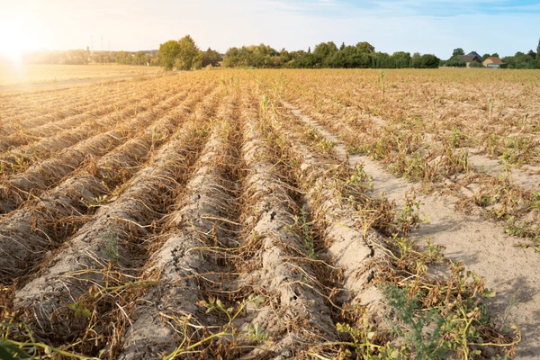
Aagricultural Raw Material Analysis
Problem Statement
Traditional farming practices often lack the utilization of data-driven decision-making processes, resulting in inefficient resource allocation and suboptimal crop yield. Farmers face challenges in accurately analyzing agricultural raw materials, leading to poor resource management and reduced profitability.

Slide 6
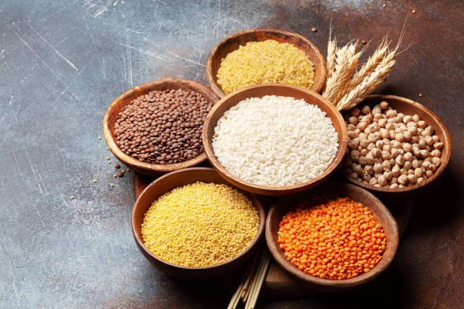
Aagricultural Raw Material Analysis
Aim and Objective
Aim:
The aim of this project is to develop a data-driven system for analyzing agricultural raw materials, providing actionable insights for farmers to optimize their farming practices.
Objectives:
Collecting and organizing raw material data from farms.
Implementing analytical techniques for data interpretation and pattern recognition.
Developing a user-friendly interface for farmers to access and utilize insights.
Proposed System/Solution:
Integration of IoT sensors for real-time data collection.
Utilization of machine learning algorithms for predictive analysis.
Development of a web-based platform for easy access and interpretation of insights.

Slide 7
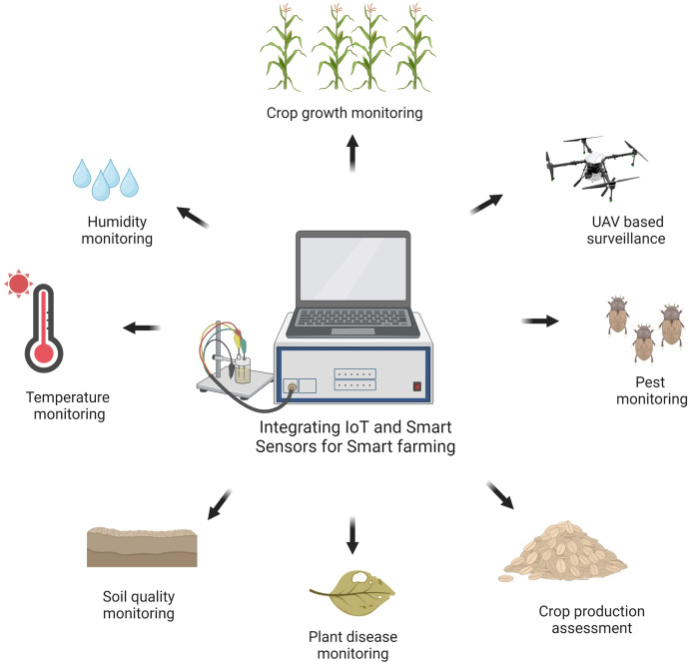
Aagricultural Raw Material Analysis
Introduction to Agricultural Raw Material Analysis
In the realm of agriculture, understanding the composition and quality of raw materials is paramount. Agricultural raw material analysis serves as the cornerstone for optimizing farming practices and ensuring sustainable agricultural production.
By analyzing raw materials, farmers gain insights crucial for informed decision-making regarding crop management, resource allocation, and marketing strategies. However, traditional farming methods often rely on subjective observations, presenting challenges such as inefficiencies and suboptimal results.
Through data-driven approaches and advanced analytical techniques, the objective is to empower farmers with actionable insights to enhance crop productivity and achieve sustainable agricultural development.

Slide 8
Aagricultural Raw Material Analysis
Importance of Data Analysis in Agriculture
Enhances Decision-Making: Data analysis provides farmers with valuable insights into crop performance, soil health, and environmental factors, enabling informed decision-making for improved agricultural practices.
Precision Agriculture: Data-driven analysis allows for precise and targeted application of resources such as water, fertilizers, and pesticides, optimizing yields while minimizing environmental impact.
Predictive Modeling: By analyzing historical data and current trends, farmers can develop predictive models for weather patterns, crop diseases, and pest infestations, enabling proactive management strategies.
Quality Assurance: Analyzing data on crop quality, nutrient levels, and contaminants ensures compliance with food safety standards and enhances the marketability of agricultural products.

Slide 9
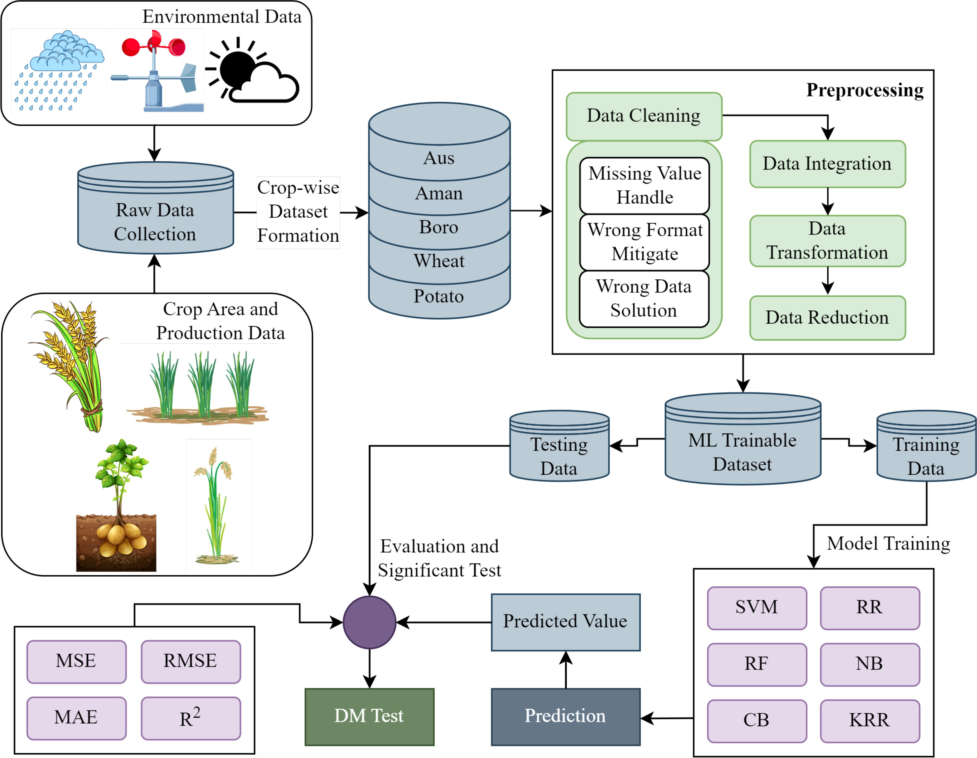
Aagricultural Raw Material Analysis
Model Development Process:
Data Preprocessing: Cleaning and organizing raw material data.
Feature Engineering: Extracting relevant features for analysis.
Model Selection: Choosing appropriate machine learning algorithms.
Training and Evaluation: Training the model on historical data and evaluating its performance.
Algorithm:
Example: Random Forest for Crop Yield Prediction
Random Forest is a versatile machine learning algorithm that can handle complex datasets and provide accurate predictions for crop yield based on various input parameters.

Slide 10
Aagricultural Raw Material Analysis
Techniques and Tools for Raw Material Analysis
Spectroscopy
Infrared spectroscopy
Near-infrared spectroscopy (NIRS)
X-ray fluorescence (XRF) spectroscopy
Chromatography
Gas chromatography (GC)
Liquid chromatography (LC)
High-performance liquid chromatography (HPLC)
Mass Spectrometry
DNA Sequencing
Remote Sensing
Data Analytics Software

Slide 11
Future Scope
Aagricultural Raw Material Analysis
Expansion of Data Sources:
Integration of Satellite Imagery: Incorporating satellite imagery data for enhanced analysis of crop health and growth patterns.
Weather Data Integration: Utilizing weather data to predict environmental impacts on crop yield.
Incorporation of Advanced Technologies:
Blockchain for Supply Chain Transparency: Implementing blockchain technology to track and trace agricultural products from farm to consumer, ensuring transparency and quality control.
Edge Computing for Real-time Analysis: Deploying edge computing devices for real-time analysis of agricultural data, enabling faster decision-making and response.
Collaboration with Research Institutions:
Partnering with research institutions for continuous improvement and innovation in agricultural data analysis techniques.

Slide 12
Conclusion
Aagricultural Raw Material Analysis
In conclusion, agricultural raw material analysis holds immense potential for revolutionizing modern farming practices. By harnessing the power of data-driven approaches, farmers can optimize their resource allocation, improve crop yield, and ensure sustainable agricultural practices.
The proposed system offers a systematic solution for addressing the challenges faced in traditional farming methods and paves the way for a more efficient and productive agricultural sector.

Slide 13
References
Aagricultural Raw Material Analysis
https://www.sciencedirect.com/science/article/abs/pii/S0301421513012731
https://www.elibrary.imf.org/display/book/9781451943061/ch004.xml
https://iopscience.iop.org/article/10.1088/1755-1315/949/1/012025/pdf.

Slide 14
Thank you !

